Slide 1

EXPLORING EMPLOYEE PERFORMANCE AND SATISFACTION IN HR EMPLOYEE DATASET
BY HARISH B
JUNE-DADS

Slide 2

WHAT? A collection of HR employee records with details on demographics, job roles, satisfaction, and performance.
WHAT WE ANALYZE?
To identify factors driving employee attrition and retention.
To understand links between salary, satisfaction, and job level.
WHAT WE SHOW?
Key drivers of employee attrition and performance.
Correlation between HR factors like income, age, and job level.

Slide 3

INTRODUCTION
Total Records
1,400+ employee records
Key Features
Age, Education, Job Role, Job Level, Monthly Income, Job Satisfaction, Environment Satisfaction, Job Involvement, Performance Rating, Years at Company, Number of Companies Worked
Employee Characteristics
Includes demographic details (age, education, experience)
Covers job-related aspects (role, level, income, satisfaction)
Information on performance, promotions, and work history

Slide 4
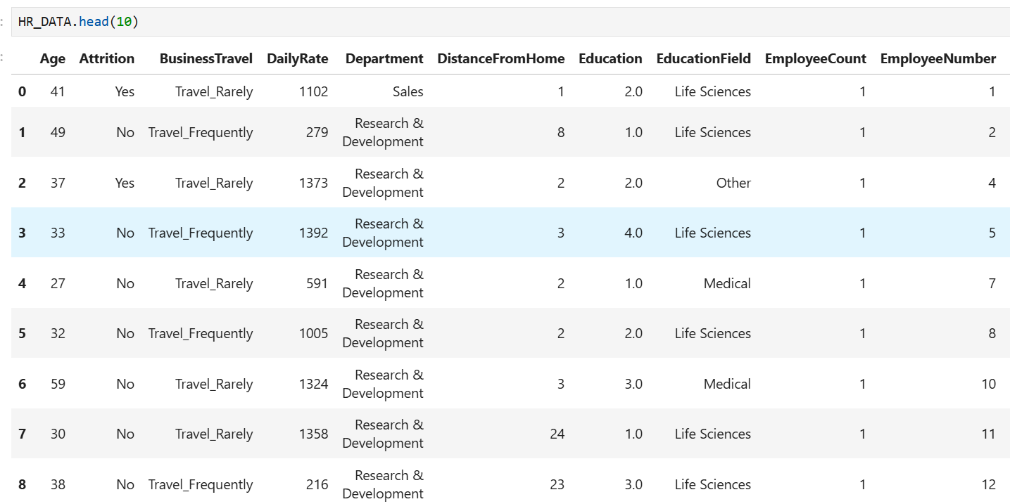
DATASET OVERVIEW

Slide 5
DATA CLEANING
Missing Values
Filled missing values in education, job satisfaction, environment satisfaction with mode.
Used median for age, income, years at company.
For categorical columns like job role, filled using most frequent category
Handling Inconsistent Values
Replaced 0 or negative values in income, years worked with NaN.
Standardized categorical labels (e.g., "Sales Exec" → "Sales Executive").
Converted binary fields (e.g., Attrition, OverTime) into Yes/No.
Outlier Detection & Treatment
Used boxplots & IQR to detect extreme salary/age outliers.
Winsorized extreme values in monthly income and years at company.
Ensured logical consistency (e.g., Years at company ≥ Years in current role).

Slide 6
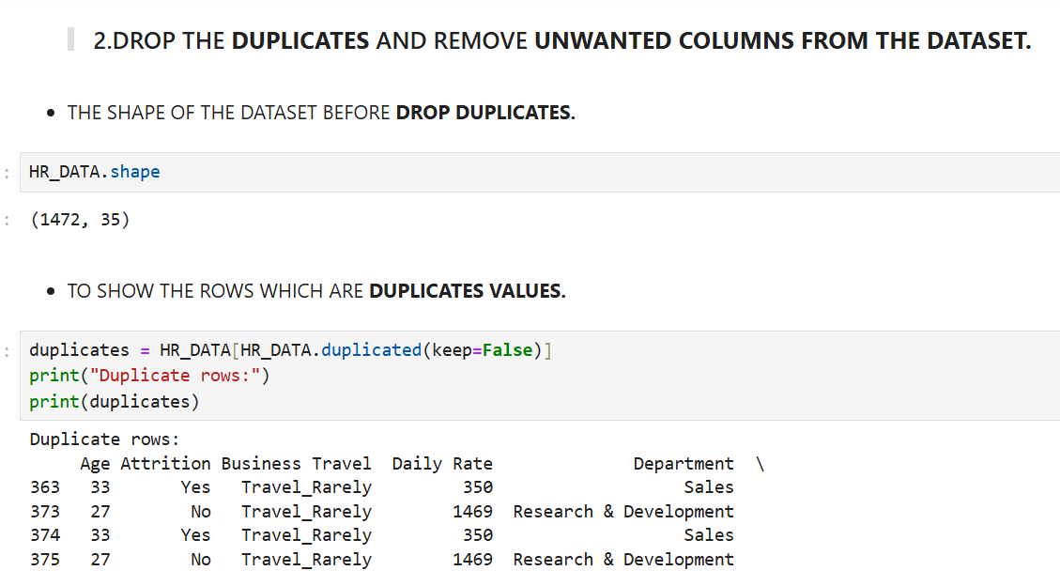
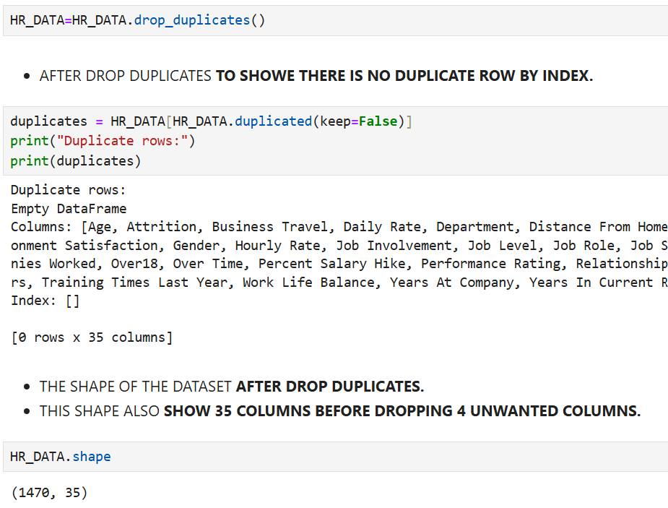
DROP DUPLICATES
BEFORE
AFTER

Slide 7
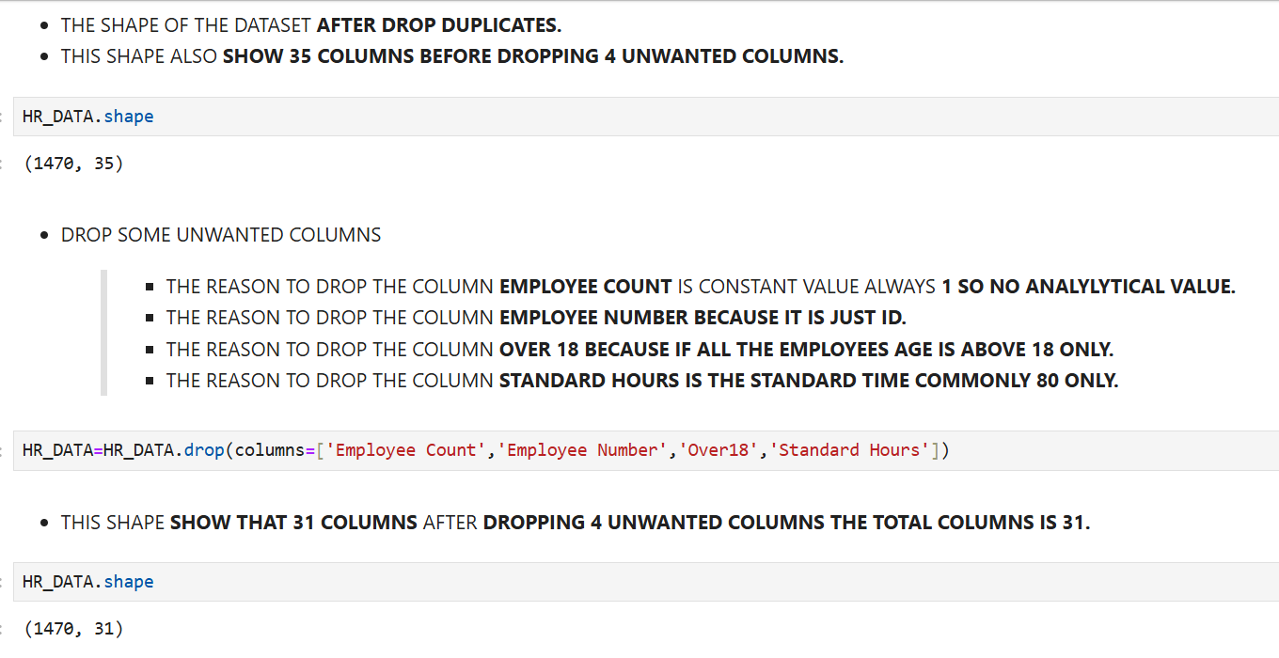
DROP COLUMNS

Slide 8
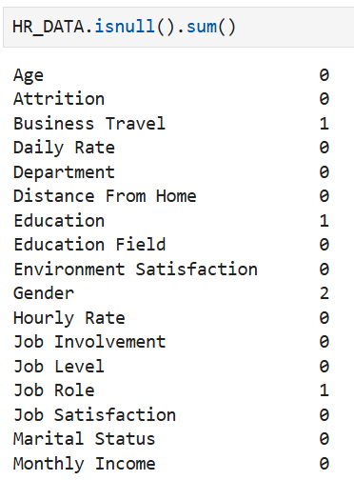
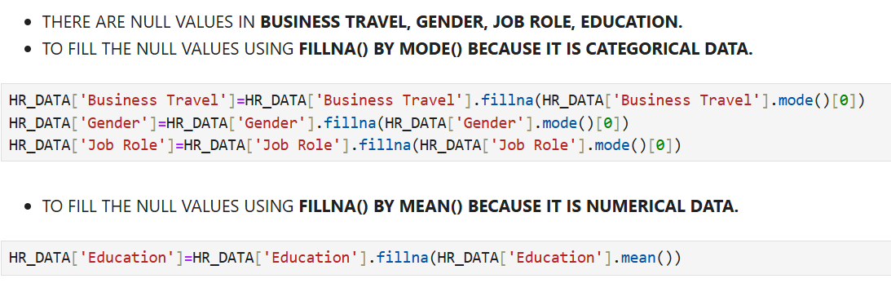
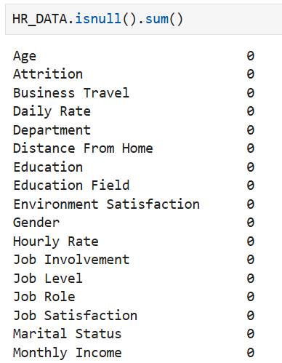
MISSING VALUES
BEFORE
AFTER

Slide 9
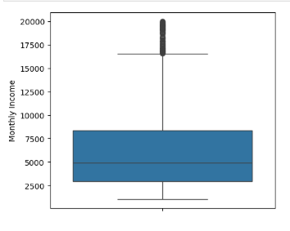
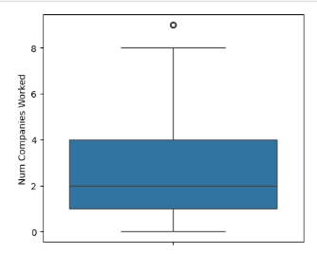
OUTLLIERS IN A DATASET
Monthly Income
Most employees earn between 3,000 – 8,000.
Median income is around 5,000.
The distribution is right-skewed, with few very high earners.
There are several outliers above 15,000 (high-income employees).
Outliers are kept because they represent real high earners, not data errors.
Num Companies Worked
Most employees worked in 2–4 companies.
Median is around 2–3 companies.
Some employees worked in as many as 8–9 companies (outliers).
A few have worked in only 1 company (loyal employees).
Outliers are kept as they represent genuine job hoppers or stable employees.

Slide 10
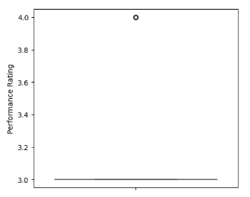
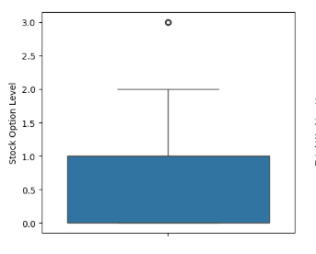
Performance Rating
Almost all employees are rated 3.
Very few are rated 4 (outliers).
No employees rated below 3.
Ratings show little variation, suggesting bias.
Outliers are kept since they highlight exceptional performers.
Stock Option Level
Majority of employees have 0 or 1 stock option level.
Median is 0 → most employees don’t receive stock options.
Very few have level 2 or 3 (outliers).
Benefits are concentrated at lower levels.
Outliers are kept as they represent employees with higher perks.

Slide 11
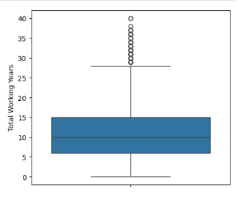
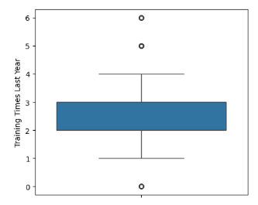
Total Working Years
Most employees have 5–15 years of experience.
Median is around 10 years.
Some employees have 35–40 years of experience (outliers).
Many mid-level employees dominate the distribution.
Outliers are kept because they represent senior leadership and highly experienced staff.
Training Times Last Year
Most employees attended 2–3 training sessions.
Median is 2 trainings per year.
Some attended 0 trainings (possible skill gaps).
A few attended 5–6 trainings (outliers).
Outliers are kept since they reflect genuine differences in training needs.

Slide 12
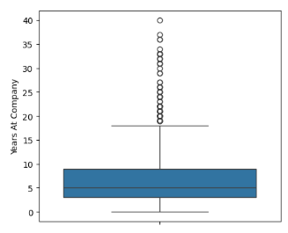
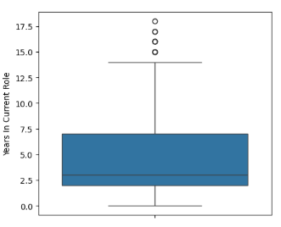
Years At Company
Most employees stayed 3–10 years.
Median is around 6 years.
Some employees stayed 30–40 years (outliers).
There is a mix of new hires and loyal employees.
Outliers are kept as they represent highly loyal long-term employees.
Years In Current Role
Median is 3 years in current role.
Many employees spent 2–7 years in the same role.
Some employees stayed 15–18 years in one role (outliers).
Long role duration may suggest career stagnation.
Outliers are kept as they highlight long-term role holders, not data errors.

Slide 13
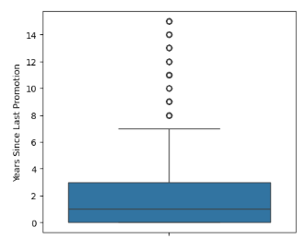
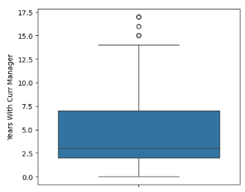
Years Since Last Promotion
Median time since promotion is 2 years.
Many employees have not been promoted for 5–10 years.
Some got promotions very recently (0 years).
Promotion cycle is inconsistent across employees.
Outliers are kept as they reveal employees who haven’t been promoted in a long time.
Years With Current Manager
Median is 3 years with current manager.
Most employees are in the 2–6 years range.
Some stayed 15–17 years with the same manager (outliers).
Indicates moderate manager rotation for majority.
Outliers are kept since they show rare long-term manager-employee relationships.

Slide 14
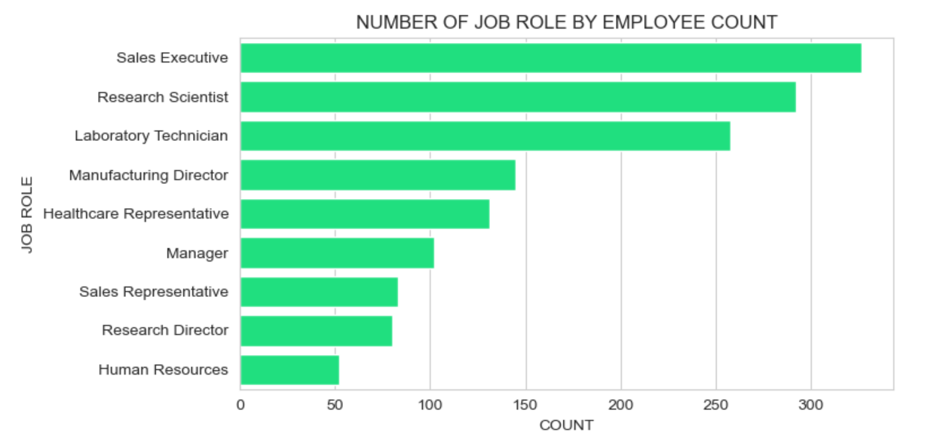
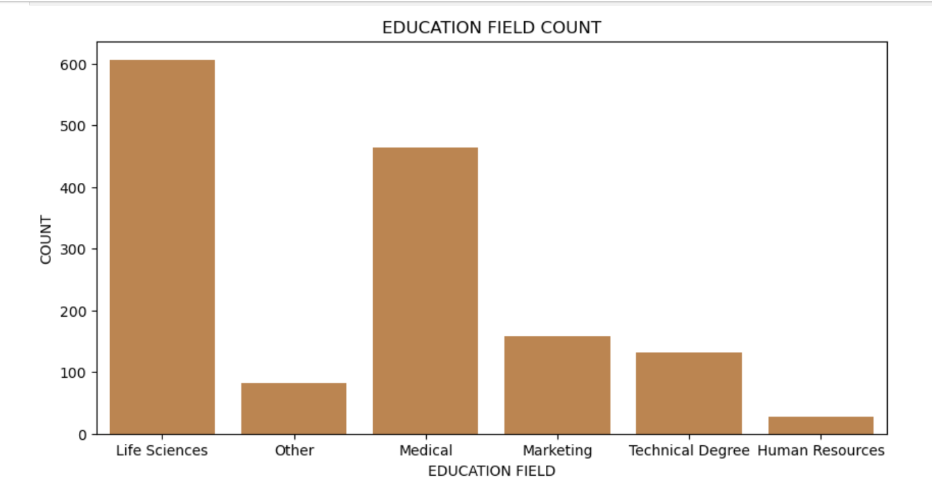
EXPLORATORY DATA ANALYSIS
1.UNIVARIATE ANALYSIS
NUMBER OF JOB ROLE BY EMPLOYEE COUNT
EDUCATION FIELD COUNT

Slide 15
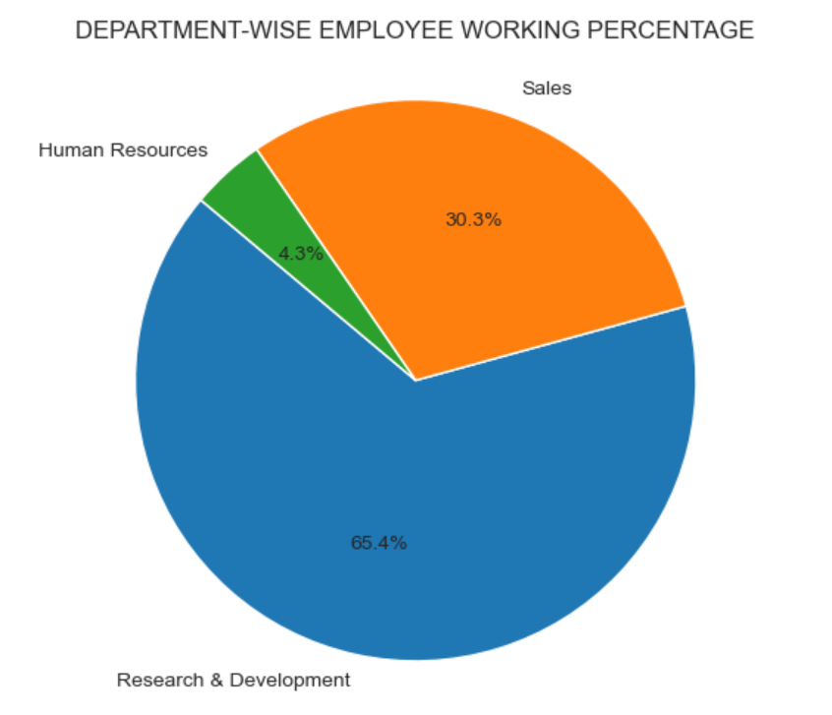
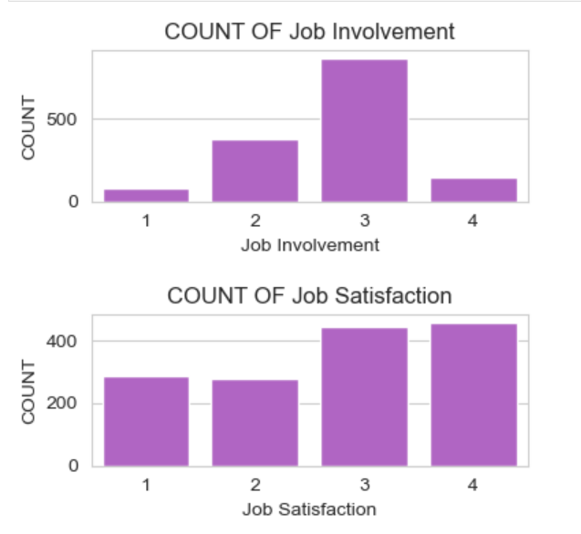
DEPARTMENT WISE EMPLOYEE WORKING PERCENTAG
COUNT OF JOB INVOLVEMENT
COUNT OF JOB SATISFACTION

Slide 16
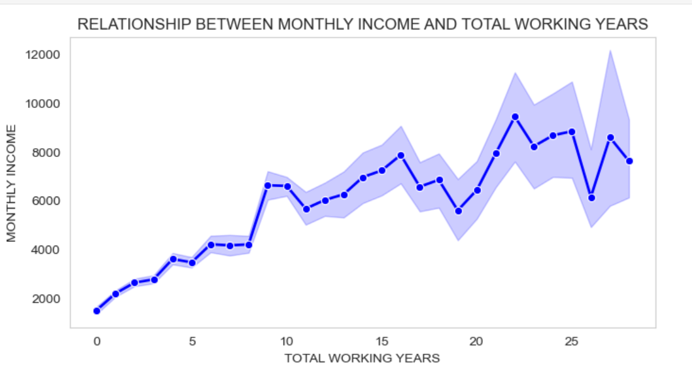
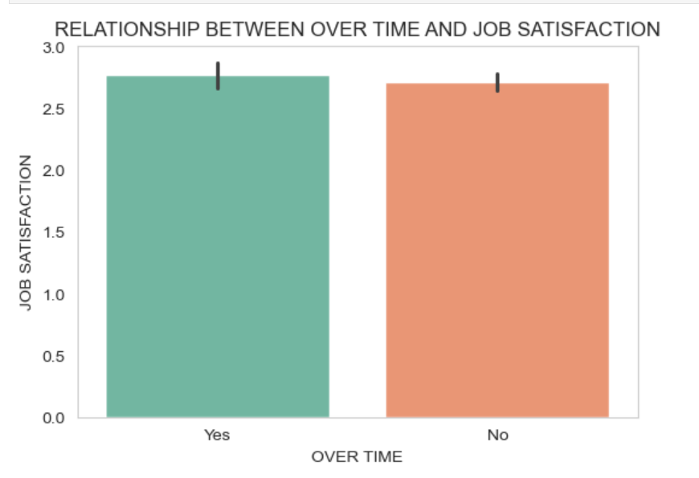
2. BIVARIATE CHART
LINE PLOT FOR MONTHLY INCOME VS TOTAL WORKING YEARS
BAR PLOT FOR OVER TIME VS JOB SATISFACTION

Slide 17
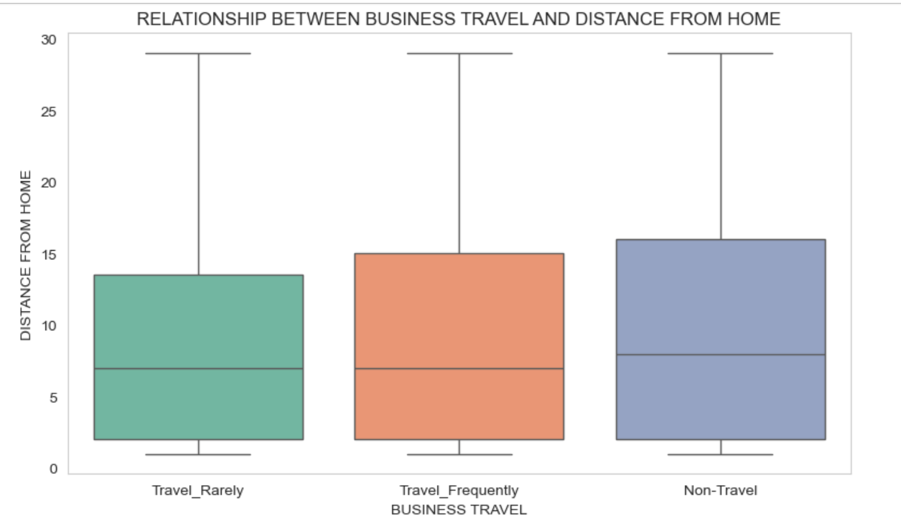
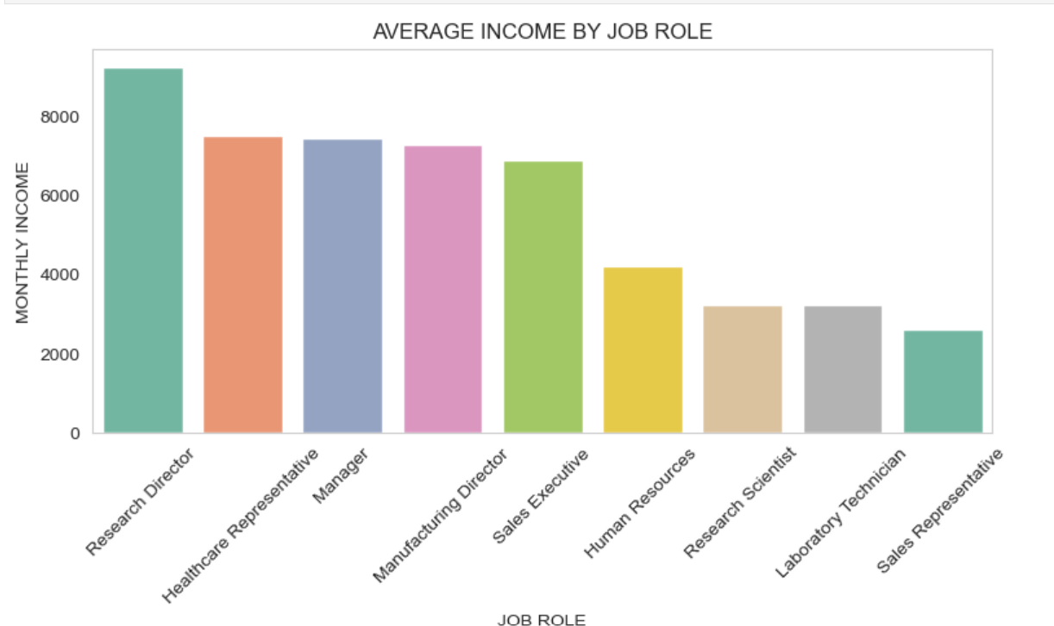
BOX PLOT FOR BUSINESS TRAVEL VS DISTANCE FROM HOME.
BAR PLOT FOR JOB ROLE VS MONTHLY INCOME.

Slide 18
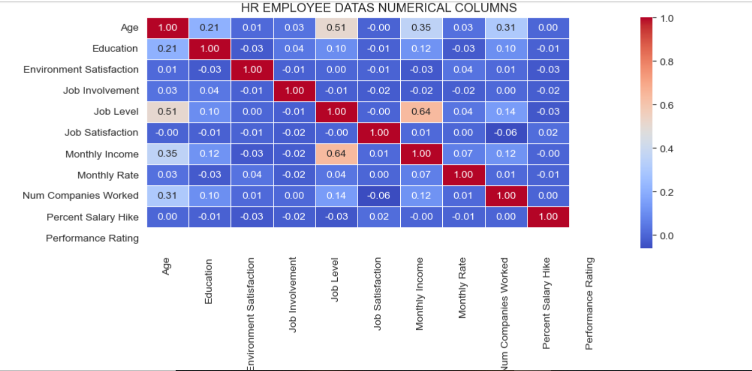
3.MULTIVARAITE ANALYSIS
HEAT MAP FOR HR EMPLOYEE DATA'S NUMERICAL COLUMNS

Slide 19
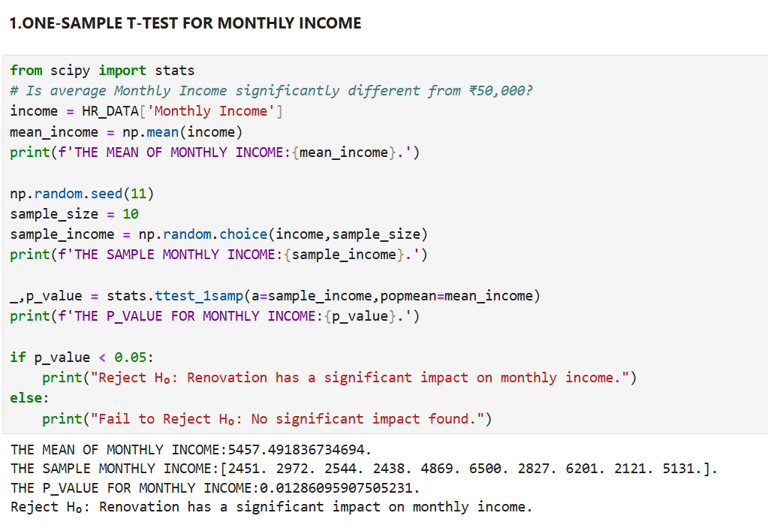
HYPOTHESIS TESTING
1.ONE-SAMPLE T-TEST FOR MONTHLY INCOME

Slide 20
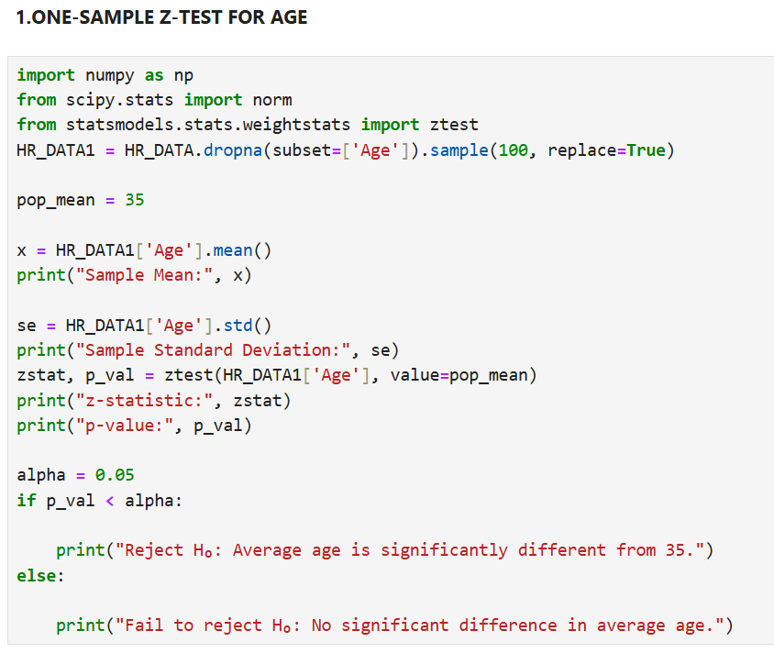
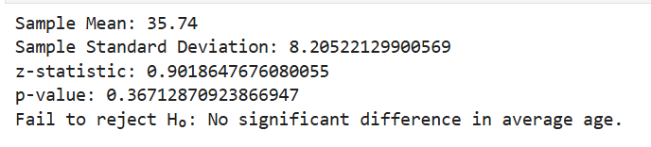
2.ONE-SAMPLE Z-TEST FOR AGE

Slide 21
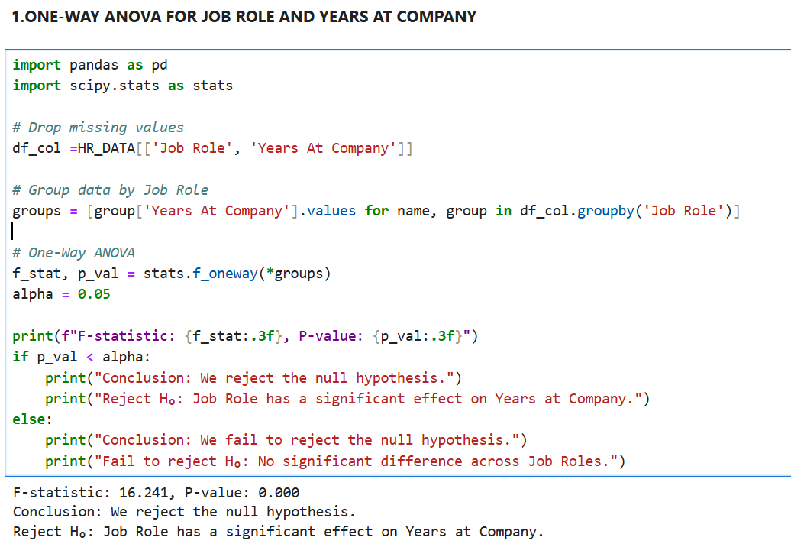
3.ONE-WAY ANOVA FOR JOB ROLE AND YEARS AT COMPANY

Slide 22
CONCLUSION
Data quality improved after removing duplicates, handling missing values,
and treating outliers—making analysis reliable.
Income and career progression are linked. Monthly income rises with job level and total working years.
Job role shows clear pay differences; departments vary in employee distribution and engagement metrics.
Hypothesis tests (t-test, z-test, ANOVA) indicate significant differences in key factors like income, age, and tenure across roles—useful for targeted
HR policies.

Slide 23
THANK YOU !

